Slide 1

Git - Rebase

Slide 2



Agenda
Talk about git
Do some demos
Flame war?

Slide 3
What is Git?
And why does it exist?
Created in 2005 by Linus Torvalds
Linux team was using a proprietary DVCS, Bitkeeper, which revoked it’s license to Linux devs because someone reverse engineered the source code.
Git is the most famous DVCS, but definitely not the only one (Mercurial was invented at exactly the same time).

Slide 4

Decentralized!
Take the Red Pill…
You can use git like any other source control system, but until you really understand the distributed source control concept it’s just a harder to use subversion…
When you clone a git repo, you’re pulling down the ENTIRE source code repository, not just the current branch you’re working on.
All git functionality is available locally with no network access.
Local commits are not necessarily final, clean up your work!

Slide 5
Master or Origin/Master?
There aren’t centralized repository servers in the DVCS model, but you still need somewhere to send your code to collaborate with others and save it in case you get hit by a bus. This is where “remotes” come in.
By default, you’ll have a local “master” branch, which tracks the “origin/master” branch.
You can fetch and update your tracking branches, and then merge or rebase to update your local branch to get up to date with changes others have made.
A pull will combine the fetch and merge into one step for convenience, but despite the convenience you may not always want to pull (which we’ll get to later)
When you have changes you want to send to others, you push them back to the origin remote!
You can have as many remotes as you want – this is really helpful for collaboration with open source projects.

Slide 6
Lightweight Branching
Since the repository is remote in a traditional system, branching is a relatively expensive process.
Traditional:
Since there’s no local repo, branch creation must be done remotely.
The only way the client can represent multiple branches is by parallel directories on the local filesystem.
Git/DVCS:
Branches are simply pointers to commits.
Instead of having multiple copies of the code base side by side to represent multiple branches, git physically rewrites your working directory to show whichever branch is active.

Slide 7

So…

Slide 8
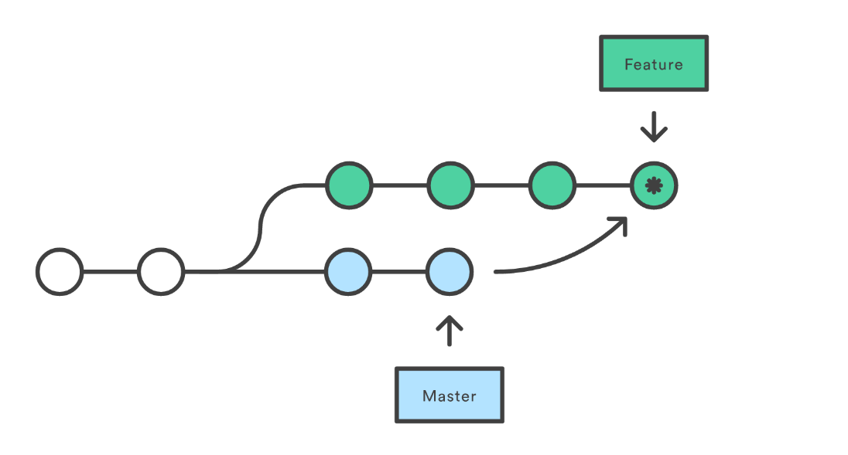
DEMO
What happens when we pull?

Slide 9
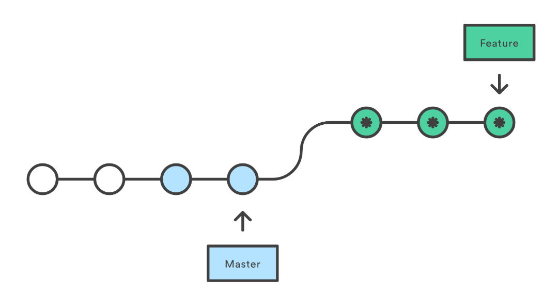
What if there was a better way?
Merge vs Rebase
Since you don’t need a server to commit, you can rewrite commit history on your local machine!
Fetching and then Rebasing avoids the automatic merge, allowing you to avoid a possibly unnecessary merge commit.
HOWEVER: only rebase commits that haven’t been pushed to a remote yet!

Slide 10
DEMO
Fetch / Rebase

Slide 11
What happens if something goes horribly wrong?
git reset –hard ORIG_HEAD

Slide 12
When do you NOT want to Rebase?
There’s plenty of people that will disagree with me on the internet, but as a safe general rule, rebasing should only be used for updating local branches with the work of others while your work is still in progress and HAS NOT been pushed to a remote.
Seeing a merge commit is always helpful when you’re merging a feature branch into an integration branch.
Rebasing implies rewriting history, which you generally only want to do locally…

Slide 13
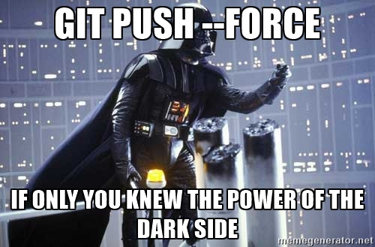
DON’T use the –force!
If you rebase (or perform some other dark magic) on commits that have already been pushed to the remote, git will get mad at you the next time you try to push, and tell you that you can fix it with a push –force.
This will work, but it works by wiping out the commits you changed on the server, which isn’t the most diplomatic solution.
Other developers will be very confused when they do their next fetch or push and git yells at them because their branch doesn’t match the remote.
There are only a few valid reasons to do a push –force, and almost none in a branch with more than one person working on it.
If you feel you need to do a –force, please notify your fellow developers before you do so they can prepare and attempt to talk you off the ledge.

Slide 14
DEMO: Cool rebase tricks…
Squashing / editing commits
git rebase –i (branch or commit base)
Cherry Picking
git cherry-pick (commit)

Slide 15
DEMO: Stash
git stash save -a (-a will include everything, including untracked)
git stash list
git stash pop

Slide 16
DEMO: Bisect
git bisect (starts bisect)
git bisect bad (current version is bad)
git bisect good commit (give a known good version)

Slide 17
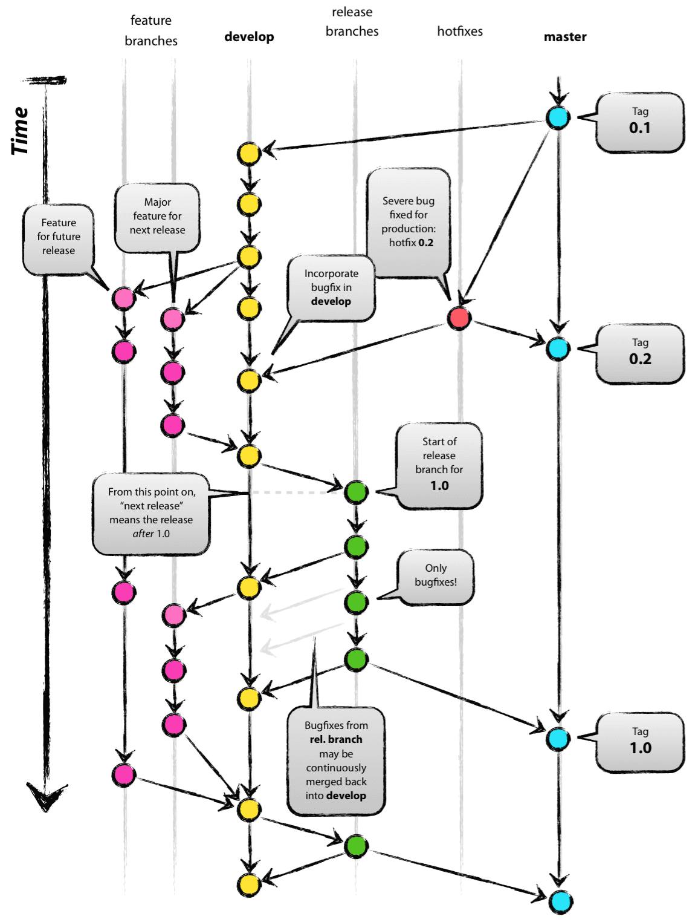
Git Flow
Branch with Style
We’ve been using Git Flow quite a bit on projects in the solutions group lately, and it seems to be taking over mindshare as the dominant git branching strategy.
Long-lived develop and master branches, master is always what’s deployed to production!
Feature branches only branch from and to develop.
When you’re ready to deploy, create a release branch, do qa testing, and merge to master when ready! All merges to master should be tagged.
Hotfix branches can be created off of master to fix production issues.

Slide 18

Thank you!

